Slide 1
2017 California Craft Brewing Industry Compensation Study Compensation Strategies, Key Study Metrics, and Industry Trends

Slide 2
Welcome & Agenda
About FutureSense® and the CCBA
Macro-Trends in the Craft Brewing Industry and the Impact on People Strategy
Leading People – Understanding Intrinsic and Extrinsic Motivators
The Workforce of the Future – Making Sense of the New Cogenerational Workplace TM

Slide 3
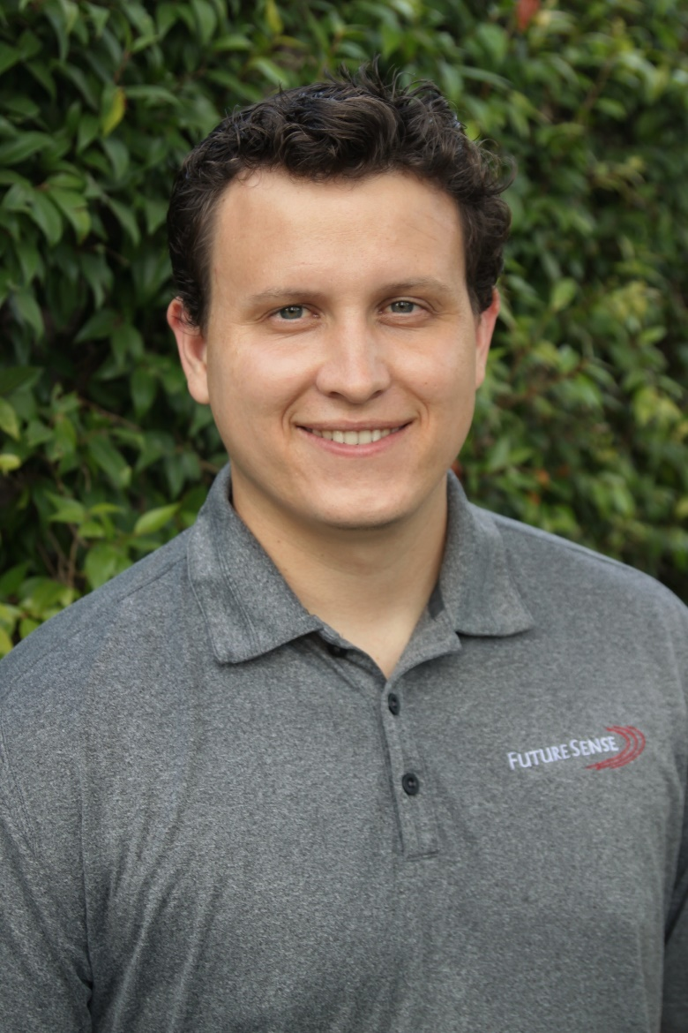
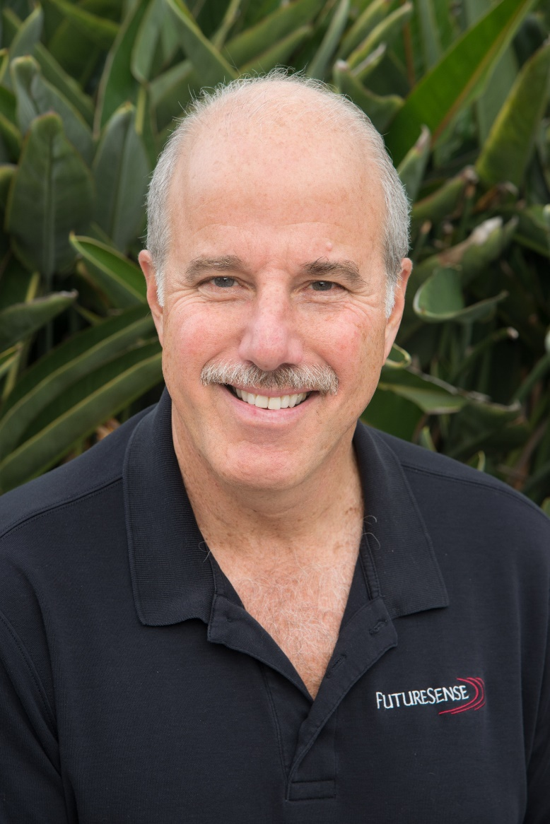
Introductions
FutureSense Team
Jack Thomas
Associate Consultant
Ben Teichman
Managing Consultant
Jim Finkelstein
CEO & President

Slide 4
Introductions
History & Background of the study
Partnership with the CCBA
Purpose of this study

Slide 5
Compensation IS NOT SYNONYMOUS WITH MOTIVATION

Slide 6
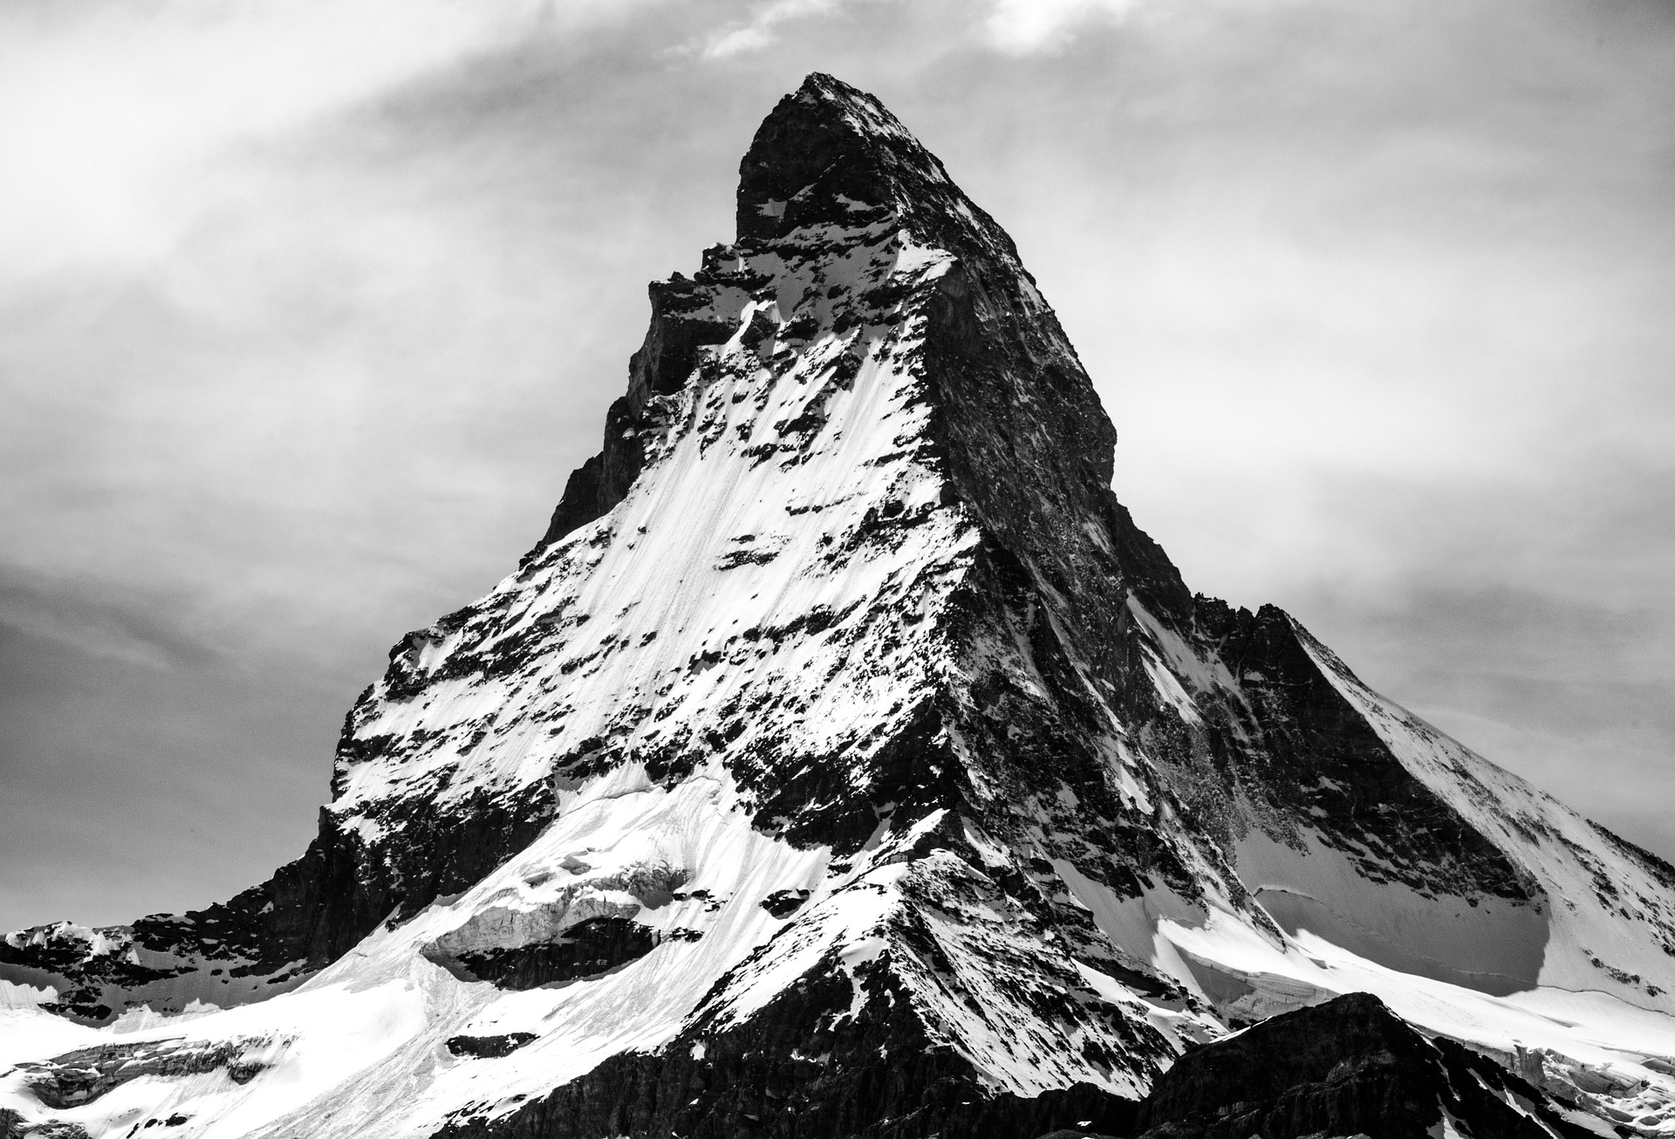
Macro-Trends in the Craft Brewing Industry and the Impact on People Strategy

Slide 7
Slower Overall Growth in Craft

Slide 8
Consolidation of Brands and Lateral Acquisitions
Big Beer continuing to grab more than its fair market share
Craft breweries creating partnerships
Similar trends in independent & family owned wine industry

Slide 9
National Closures and Openings

Slide 10
Expansion

Slide 11
Leading People – Understanding extrinsic and intrinsic Motivators

Slide 12
Extrinsic Motivators
Compensation Philosophy
Sources of Data
Competitive Position
Talent Marketplace

Slide 13
Extrinsic Motivators
Fixed Pay
Job Title | Job Code | Statewide
 |  | 25th | Median | 75th | # Orgs
Account Manager/Rep - Comprehensive | 101d | $17.63 | $23.29 | $27.11 | 22
Sales Manager - Comprehensive | 128d | $28.22 | $31.25 | $37.20 | 11
Marketing Manager | 138 | $27.00 | $33.68 | $37.50 | 13
Brewer (2nd Level) | 104 | $19.06 | $21.00 | $24.04 | 33
Brewmaster (Highest Level) | 105 | $23.23 | $28.85 | $35.28 | 38

Slide 14
Extrinsic Motivators
Incentives & Commission
STI
Types of STI
Simple, Equitable, Timely, Relevant, Significant
LTI
Types of LTI
Commission
Types of Commission
Different motivation by employee types
Commission Metrics

Slide 15
Extrinsic Motivators
Benefits & Work Life
Be Competitive
Health & Dental Insurance
Time Off
Get Creative with Perks and Work Life Balance
“Family” feel
Student Debt Forgiveness
Remote Work

Slide 16
Intrinsic Motivators
Beyond Compensation

Slide 17
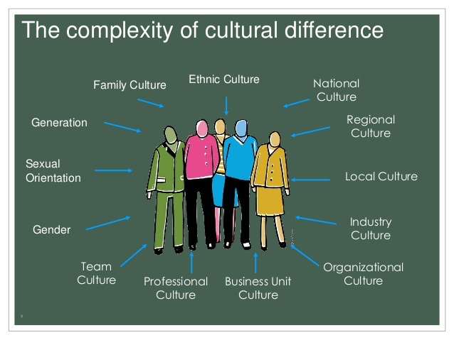
Intrinsic Motivators
Culture & Purpose

Slide 18
Intrinsic Motivators
Purpose Metrics

Slide 19
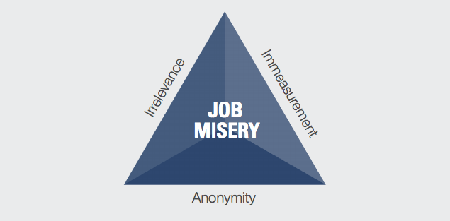
Intrinsic Motivators
Purpose Benefits
- The Table Group, a Patrick Lencioni Company

Slide 20
The Workforce of the future
Making Sense of the New Cogenerational Workplace TM

Slide 21
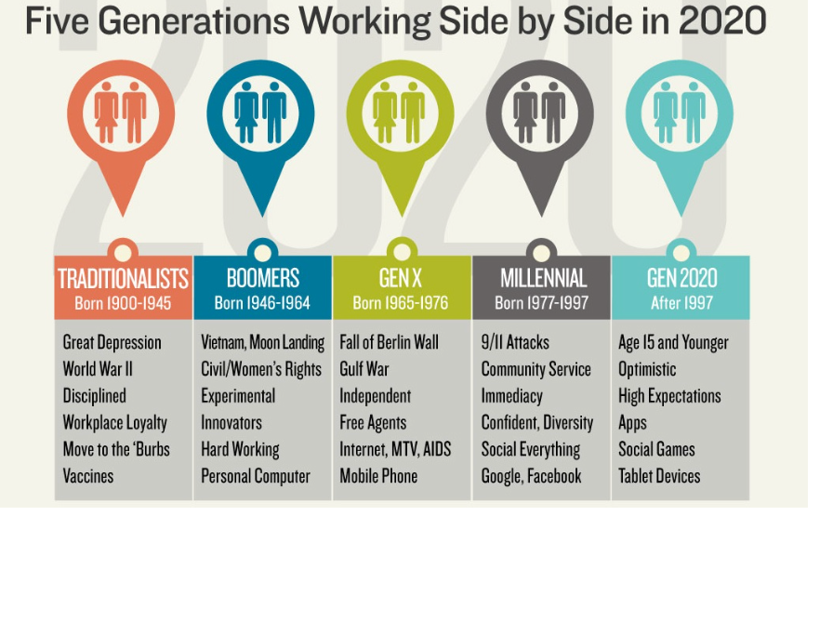

Slide 22
COGENERATIONAL WORKPLACE TM FROM 100,000 FEET
COMMUNICATION ECONOMIC POLITICAL PSYCHOLOGICAL SOCIOLOGICAL

Slide 23
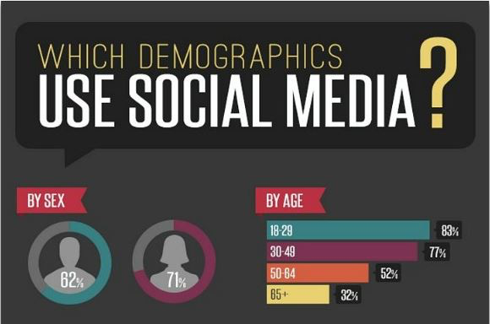

Slide 26
-Matthew Larsen Morava

Slide 28
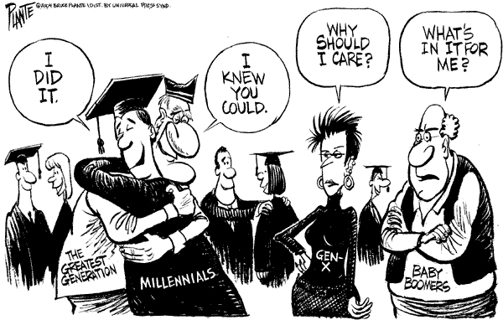
GENERATIONAL BIAS SYNDROME (“GBS”)

Slide 29
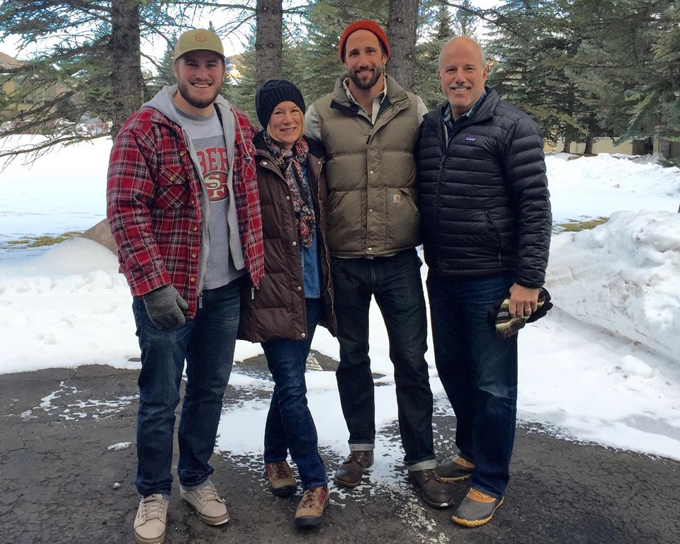
Box Be Gone
Boomer
Millennial

Slide 30
UNIQUE MOTIVATIONAL PROFILES

Slide 31
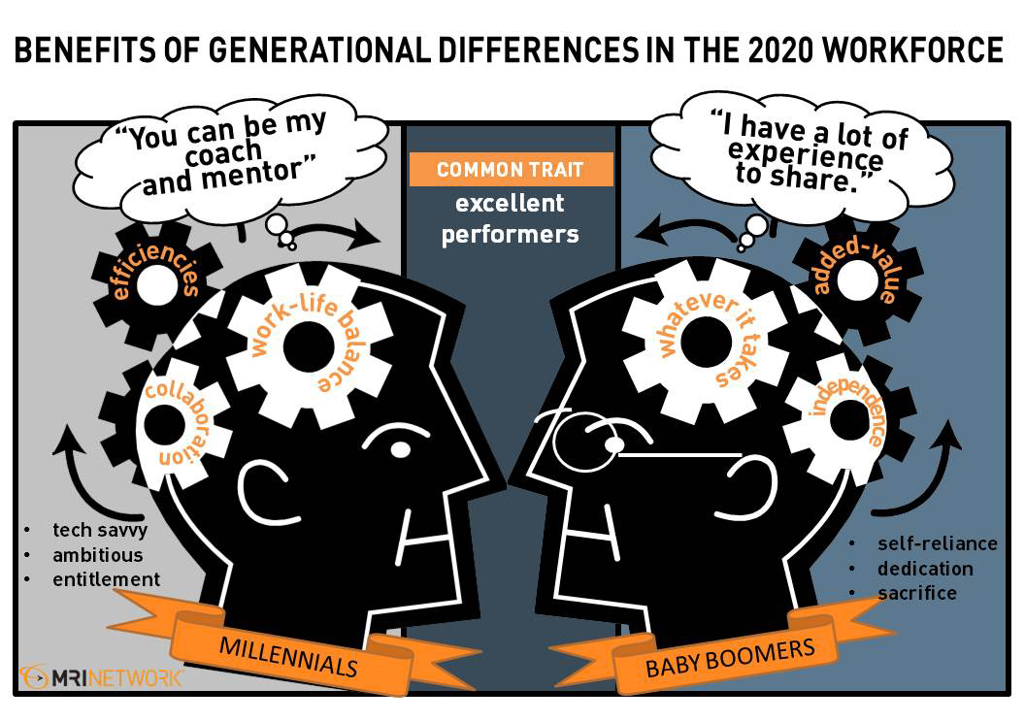

Slide 32
Concluding Thoughts

Slide 33
Please visit us at:
www.FutureSense.com or
Jack@FutureSense.com
for any questions regarding the 2017 CA Craft Brewing Industry Compensation Study or our presentation today

