Slide 1
Projecting Growth and Funding: You survived your first year of business…
What’s next?
Mann, Urrutia, Nelson, CPAs
& Associates, LLP

Slide 2
Lou Catalano, CPA
Partner
Mann, Urrutia, Nelson, CPAs & Associates, LLP
2901 Douglas Boulevard, Suite 290
t. 916.774.4208 f. 916.774.4230
e. LPC@muncpas.com
Presenter
Information
www.muncraftbeverage.com

Slide 3
Topics of Discussion
Statement of Cash Flows – What Is It?
Key Metrics
Projecting Cash Flow Model
Tax Savings to Unlock Cash Flow

Slide 4
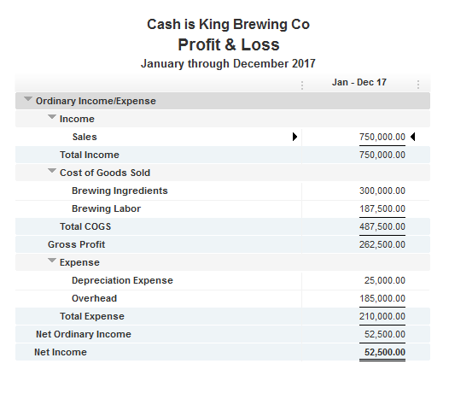
Where did the cash go?

Slide 5
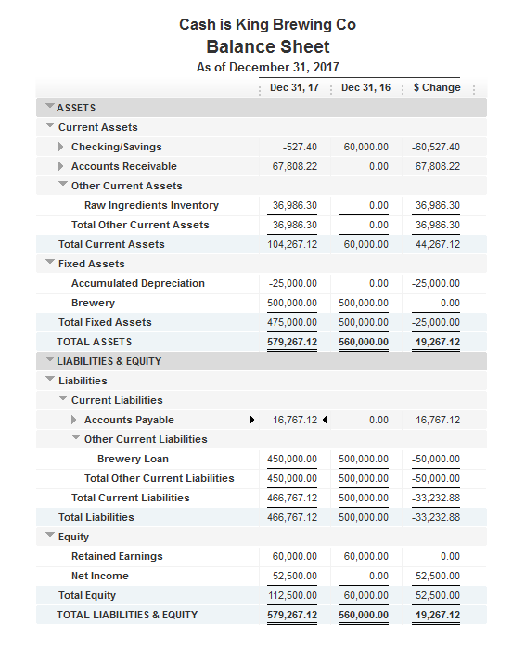
Where did the cash go?

Slide 6
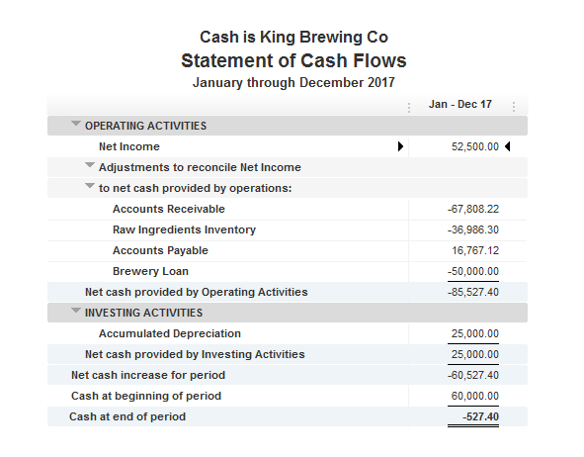
Statement of Cash Flows

Slide 7
Key Ratios
A/R Days
Inventory Days on Hand
A/P Days
Profitability

Slide 8

A/R Days
$\frac{Accounts Receivable}{Total Sales} X 365=$ A/R Days
$\frac{67,808}{750,000}$ X 350 = 33 Days
Goal: Lowest Possible Number
Responsibility: Collections, Deliveries, Sales Reps

Slide 9
Inventory Days on Hand
$\frac{Inventory}{Cost of goods sold} X 365=$ Inventory Days on Hand
$\frac{36,986}{300,000}$ X 365 = 45 Days
Goal: Lowest possible number without running out
Responsibility: Purchasing/Ordering

Slide 10
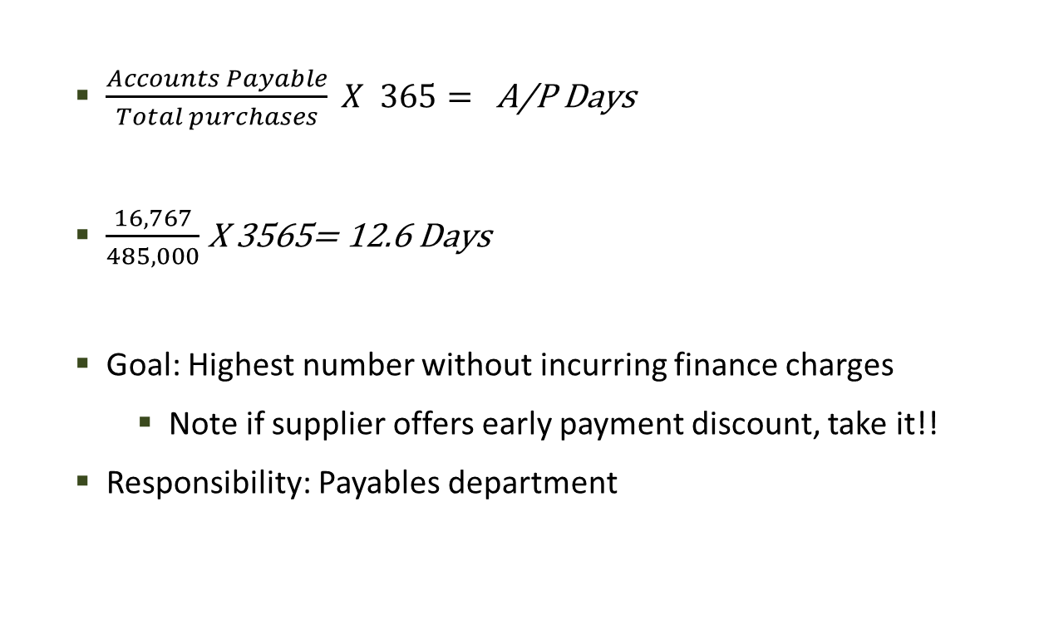
A/P Days
$\frac{Accounts Payable}{Total purchases} X 365=$ A/P Days
$\frac{16,767}{485,000}$ X 3565= 12.6 Days
Goal: Highest number without incurring finance charges
Note if supplier offers early payment discount, take it!!
Responsibility: Payables department

Slide 11
Profitability
Gross Margin
Operating Expenses
Fixed vs. Variable expenses
Bulk Discounts

Slide 12
Cash Flow Projection Model
Step 1 – Calculate your metrics based on actual numbers (or estimate if brand new)
Step 2 – Project growth or retraction in projection period
Step 3 – Calculate anticipated changes in cash flow accounts
Step 4 – Run model for projection period

Slide 13
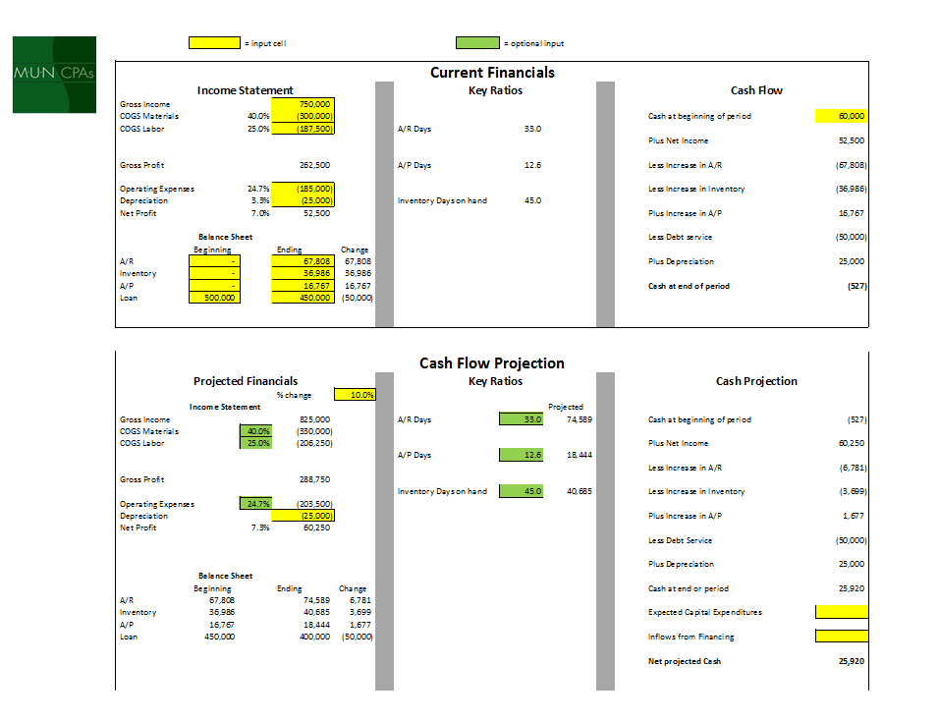
Review the model

Slide 14
Tax Considerations
Tax Credits/Deductions
Section 199 Deduction QBI Deduction
FICA Tip Credit (Tasting Room)
Research and Development
Timing Depreciation (Bonus, Section 179)
WOTC Federal Tax Credit
California Competes
Sales Tax Exemption
Profit Sharing

Slide 15
Thank you for attending! If you have any questions on any of the material covered today, please feel free to reach out to us for a complimentary consultation.
Lou Catalano, CPA
Partner
Mann, Urrutia, Nelson, CPAs & Associates, LLP
2901 Douglas Boulevard, Suite 290
t. 916.774.4208 f. 916.774.4230
e. LPC@muncpas.com
ww.muncpas.com
Presenter
Information

