Slide 1
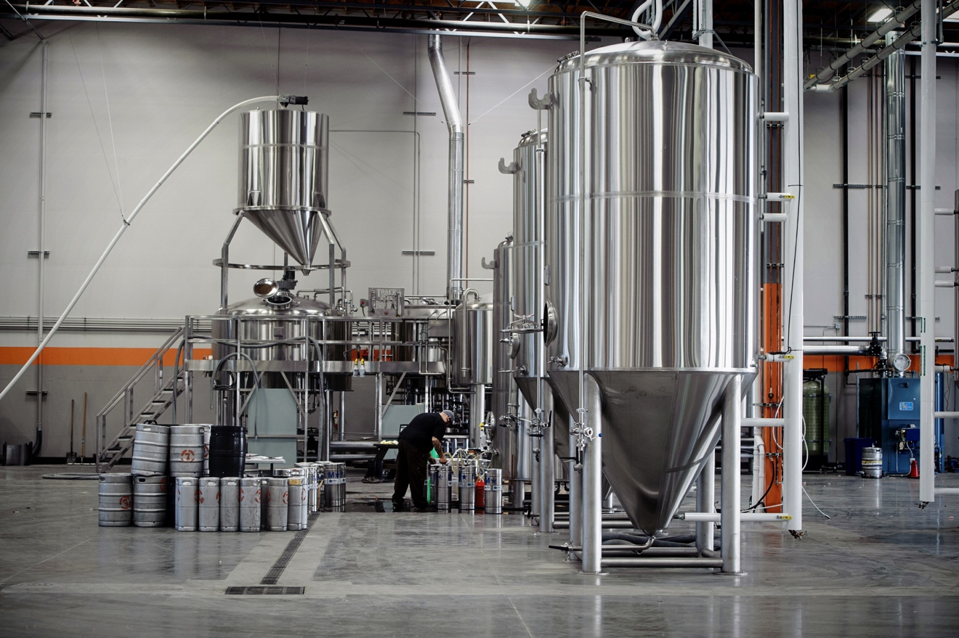

Slide 2
5-Step Plan To Avoid Harassment & Discrimination Claims
Amy L. Lessa, Esq.
California Craft Brewers Association | www.CaliforniaCraftBeer.com

Slide 3
Today’s Agenda:
Why Do This? Top Ten Reasons
Getting On The Same Page –
Legal Definitions of:
Protected Class
Discrimination
Harassment
Retaliation
3. Five-Step Plan To Avoid Claims
4. What Next?

Slide 4
TOP TEN REASONS YOU SHOULD CARE ABOUT THIS PRESENTATION

Slide 5
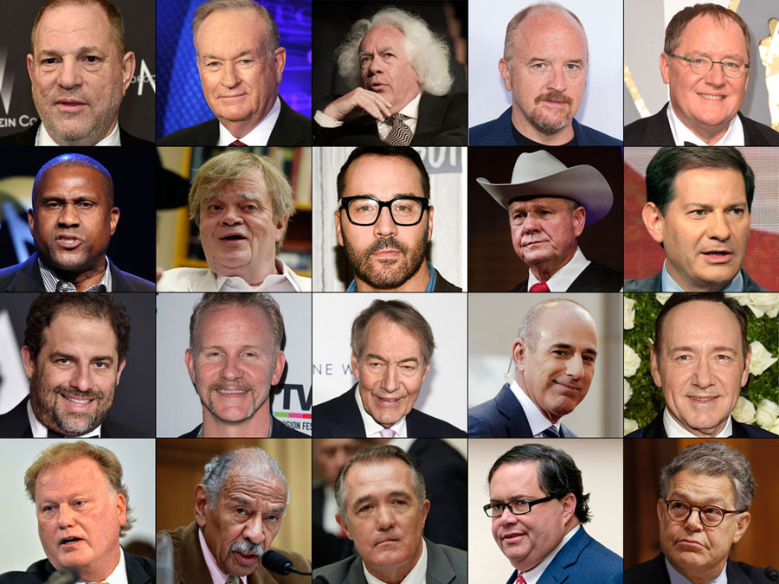
1. #MeToo movement isn’t slowing down

Slide 6
2018 – The Year of the #MeToo Movement and the “Weinstein Effect”
CA employers should expect an increase in the number of sexual harassment complaints and claims.
And an increase in the amount of money it takes to settle claims.
Over two dozen bills were introduced in the Legislature in 2018!

Slide 7
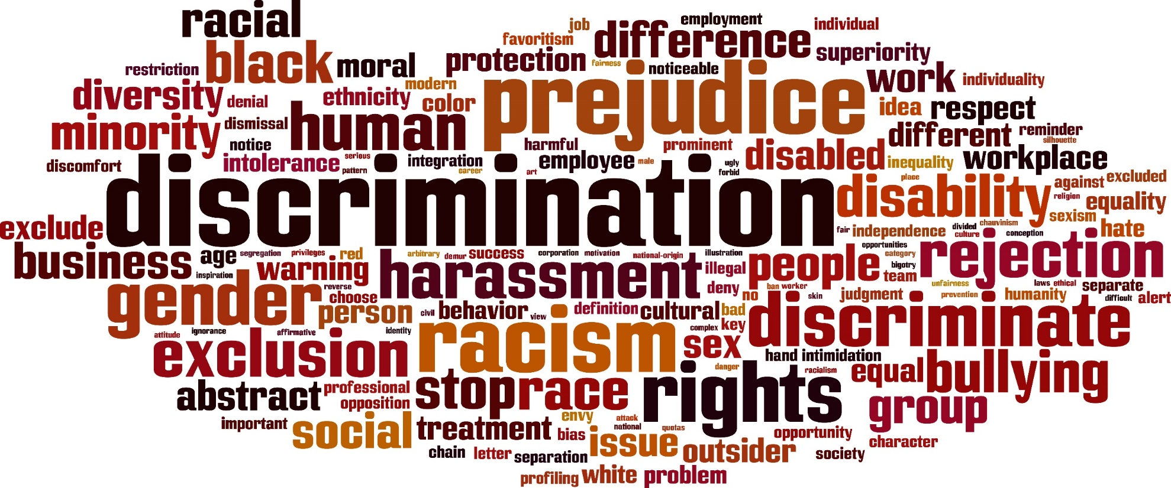
2. Can’t ignore other possible claims

Slide 8
Claims are costly, time-consuming, humiliating, and stressful for all involved
4. They hurt the reputation of those involved and the organization

Slide 9
5.
Professionalism leads to higher productivity
6.
Maintaining high morale means lower turnover

Slide 10
7. You can no longer deduct the cost of sexual harassment settlements if they involve a confidentiality or non-disclosure agreement
8. Non-disclosure agreements and confidentiality provisions are now prohibited for sexual harassment claims in CA

Slide 11
SB 820 – Stand Together Against Non-Disclosure (STAND) Act
#MeToo movement has focused on non-disclosure agreements or “secret settlements” involving sexual harassment claims.
Critics contend these clauses keep claims secret and allow perpetrators to continue harassing victims.

Slide 12
SB 820 – Stand Together Against Non-Disclosure (STAND) Act
Prohibits confidentiality or non-disclosure clauses in any settlement agreements involving:
Sexual harassment
Sexual assault
Workplace discrimination based on sex, or failure to prevent an act of such harassment or discrimination, or retaliation.
Applies to more than just “sexual harassment” claims – covers any “workplace discrimination based on sex.”

Slide 13
SB 820 – Stand Together Against Non-Disclosure (STAND) Act
Plaintiff can still ask for confidentiality:
Confidentiality clause that shields identity of claimant (or facts that would reveal identify) may be included at the request of the plaintiff.
Don’t Show Me The Money:
Does not prohibit a provision that precludes the disclosure of the amount paid in settlement of a claim.
Applies to agreements entered into on or after January 1, 2019.

Slide 14
SB 820 – Stand Together Against Non-Disclosure (STAND) Act
Does not cover “pre-litigation” settlement agreements:
Law applies to covered claims “filed in a civil action or a complaint filed in an administrative action.”
But appears to not apply to settlements reached in the “pre-litigation” phase – such as where a demand letter has been sent but no civil action or administrative claim filed yet.

Slide 15
9. You could be named in a lawsuit, held liable under the law, and/or be held accountable under company policy
10. Taking the recommended steps we suggest will offer your organization a legal defense

Slide 16
LEGAL DEFINITIONS YOU NEED TO KNOW ABOUT

Slide 17
> protected class
> discrimination
> harassment
> retaliation

Slide 18
“protected class”
Groups protected from harassment or discrimination
Categories that you can’t take into account when making hiring decisions or you will commit discrimination
If offensive behavior is targeted at an employee because of a protected class, it becomes harassment

Slide 19
What are the protected classes?
FEDERAL LAW includes…
Race
Color
Religion
National origin
Gender/sex (includes pregnancy)
Age (if 40 or above)
Disability (mental/physical)
Veteran status
Family leave
STATE/LOCAL LAW adds others such as…
Sexual orientation
Gender identity/transgender status
Marital status
Age
Genetic information
Citizenship status
Injured workers
Domestic violence leave
Crime victims
Expunged juvenile records
Lawful off-duty activities
Etc.

Slide 20
“discrimination”
Making an employment decision based on an employee or applicant’s protected status
Hiring
Firing
Compensation
Assignments
Transfers
Promotion
Demotion
Layoff
Evaluations
Discipline
Training
Benefits
Resources
Other terms and conditions…

Slide 21
So what can you take into consideration?
Skills
Experience
Performance
Education
Seniority
Merit system
Quantity/Quality
Training
Geographic location
Etc.

Slide 22
“harassment”
Offensive, intimidating, or hostile behavior related to any of the protected characteristics
Unreasonably interferes with work performance
Objectively offensive behavior (to a reasonable person) that subjectively offends the victim (offensive to that specific employee)

Slide 23
Harassment can come in many forms…
QUID PRO QUO BEHAVIOR
“this for that”
Offer of job benefit in exchange for sexual favors
Threat of job detriment if victim does not go along with request

Slide 24
Harassment can come in many forms…
Hostile Work Environment
Unwelcome behavior;
Offensive to the reasonable man or woman;
Severe or pervasive; and
Alters working conditions to create an abusive working environment.

Slide 25
Harassment can come in many forms…
Hostile Work Environment
Verbal Behavior
Physical Behavior
Visual Behavior

Slide 26
“retaliation”
Adverse employment action
Taken against an employee who has made a complaint, opposed an unlawful practice, or participated in protected activity
With a motive connecting the two

Slide 27
WARNING!!
You cannot allow your managers to treat workers in an unprofessional manner just because they aren’t motivated by protected class status or retaliatory intent (i.e., “bullying” conduct)
“Equal Opportunity Jerk” defense is not pleasant!

Slide 28
ATTENTION!!
Just because an employee’s conduct does not rise to the legal level of “harassment,” “discrimination,” or “retaliation” does not mean you cannot discipline them for unprofessional conduct

Slide 29
5-STEP PLAN TO AVOID CLAIMS

Slide 30
Up-to-date policies
Dissemination
Training for managers
Prompt investigation
Enforcement

Slide 31
Step 1: Make sure your policies match modern standards
“Zero tolerance”
Include definitions of key terms
Include examples of unprofessional conduct
Reporting policy that encourages complaints
Include several avenues for complaints
Guarantee no retaliation

Slide 32
Step 2: Disseminate your policies in a thoughtful manner
Distributing it at time of hire is just the start
HR representative should describe policy at hire
Make it available online
Periodically provide standalone copies to all (preferably from high-ranking executive)
Receive and retain acknowledgements
Update policy on regular basis and
redistribute

Slide 33
Step 3: Train your managers
Misconduct by managers could mean automatic liability
Strict liability
Managers shouldn’t ignore conduct they think is “welcomed” or “voluntary”
No room in your company to allow extra leeway to certain employees, whatever the reason
“that’s just Harvey being Harvey!”
“he likes to give hugs but he’s harmless”

Slide 34
Step 4: Promptly investigate any issues raised
Need to take immediate action
Delays could send the wrong signal, and could be exploited in a subsequent legal proceeding
HR representatives should take the lead
No cookie-cutter template, but here are some best practices…

Slide 35
Investigation Steps:
Try to obtain a written report from victim
All relevant witnesses should be interviewed
Obtain all evidence (emails, texts, documents, etc.) before concluding the investigation
Take detailed notes, and be prepared for them to be an exhibit to a lawsuit one day
Take reasonable steps to separate accused from victim
Don’t ignore older complaints that arise
Take appropriate corrective action

Slide 36
Step 5: Consistently enforce policy
Take action sufficient to ensure the behavior is not reasonably likely to occur again
Verbal warning
Written warning
Professionalism training
Performance plan
Suspension
Demotion
Termination
Do not go easy on high-performing or high-ranking employees

Slide 37
What Should I Do With All Of This Information?

Slide 38
What do I do with all of this?
The Obvious – You are Ready!
Discrimination Posting Requirements: state and federal posters.
Nondiscriminatory Hiring Practices
Fair complaint and investigation procedures, including protecting against retaliation
Unbiased personnel decisions/actions
Updated and fair policies that are applied uniformly – zero tolerance
Solid and compliant training
Equal pay, for equal work

Slide 39
What do I do with all of this? For Harassment, Discrimination, Retaliation
Key Tips from Weinstein:
Don’t hold high performers to a different standard and don’t allow your managers to either.
Act quick and be thorough. Delays send the wrong signal, and could be exploited in a legal proceeding.
Remember, no matter how far outside the scope of employment the behavior is, the company can still be liable. Claims for failure to prevent are common.
Err on the side of caution. The movement is not slowing down. Companies and employees are hyper aware of behavior.

Slide 40
What else can you do?
And finally . . . Arbitration is more important than ever in light of the #MeToo climate
If you don’t have an arbitration agreement, consider implementing one

Slide 41
Thank you!
Additional questions? Email alessa@fisherphillips.com
Both the slides and a recording of this presentation available at www.CaliforniaCraftBeer.com
Please email feedback@californiacraftbeer.com with questions or comments
California Craft Brewers Association | www.CaliforniaCraftBeer.com

