Slide 1
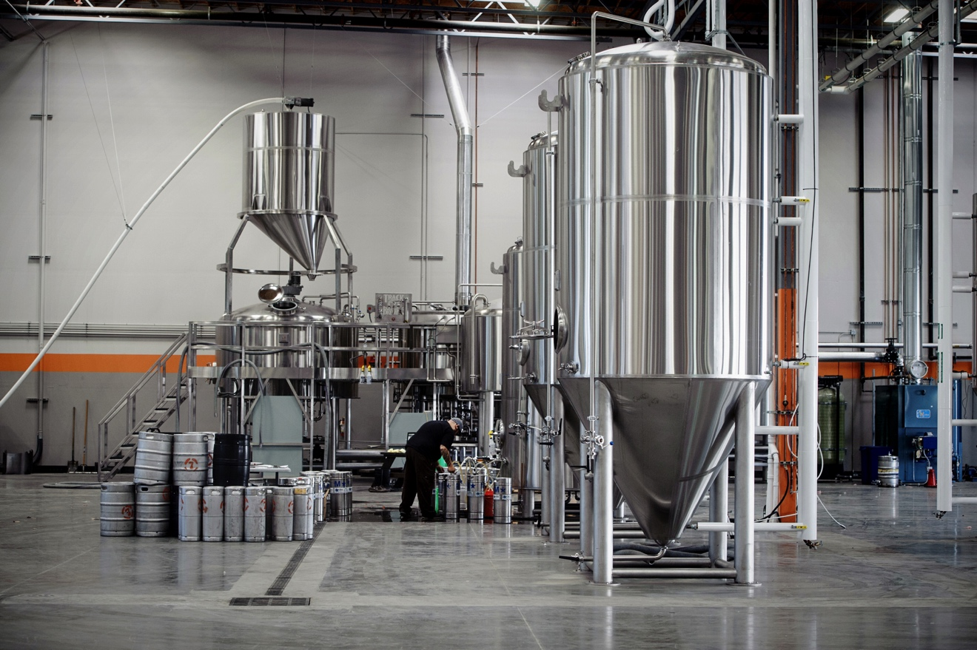
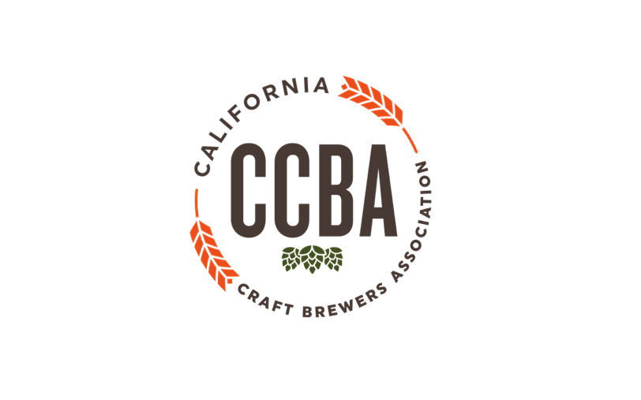

Slide 2
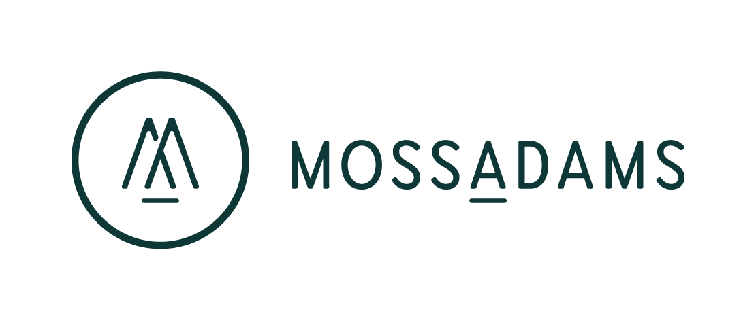
Tax Planning Opportunities for Independent Brewers Under the “Tax Cuts and Jobs Act” (TCJA)
Kirk Faris, CPA, Moss Adams LLP
California Craft Brewers Association | www.CaliforniaCraftBeer.com

Slide 3
The (Simplified) Brewery Lifecycle
Financial Status
Raising capital
Cash-flow negative
Tax Concerns
Entity structure
Payroll/TTB Taxes
Flow-thru losses deductible for owners?
Financial Status
Managing growth needs (new equipment, etc.)
Cash-flow trending to positive
Tax Concerns
Depreciation vs. operating income
Tax credits
Financial Status
Potential distributions/buyouts for investors
Cash-flow positive
Tax Concerns
Tax rates (capital gain vs. operating income)
Tax timing (accelerate deductions, defer income)
Mandatory tax distributions
Tax credits
Start-up
Growth
Maturity
California Craft Brewers Association | www.CaliforniaCraftBeer.com

Slide 4
Highlights of Tax Reform Provisions
All Taxpayers
Increased expensing for tangible property (Bonus & 179)
Business Interest Limitations
Expanded access to simplified accounting methods
Restrictions on Meals/Entertainment and Fringe Benefits
Domestic Production Activity Deduction Repealed
C-Corporations
Lowers corporate tax rate from 35% to 21% and AMT repealed
Corporate NOL limitations
Flow-Throughs (S-Corporations, Partnerships, LLC’s)
20% Qualified Business Income Deduction
Owners
Reduced overall tax rates offset by limitations on itemized deductions
Limitations on excess business losses from pass-throughs
Craft Beverage Modernization Act (Beer)
Reduced Beer Tax Rates (Small Brewers - $3.50 / barrel on first 60K barrels)
Transfer of Beer in Bond (Increases access to collaborative brews)
California Craft Brewers Association | www.CaliforniaCraftBeer.com

Slide 5
Bonus Depreciation
Bonus deprecation is increased to 100% for qualified property acquired and placed in service after Sept 27, 2017 but before Jan 1, 2023
Pre-reform law: Bonus depreciation set at 40% for 2018
Qualified property includes:
New and used property, but must be in an arm’s length transaction
Qualified property does not include:
Most real property (ex: Land, Buildings)
“Qualified Improvement Property”
Leasehold improvements
Restaurant Improvements
Retail Improvements
Planning Opportunity – New equipment purchases can significantly reduce taxable income
California Craft Brewers Association | www.CaliforniaCraftBeer.com

Slide 6
Section 179 Deduction Expanded
Increases the amount a taxpayer may expense to $1,000,000
Pre-reform law: $510,000
Increases the phase-out threshold to $2,500,000
Pre-reform law: $2,030,000
Expands eligibility of Section 179 to include:
Qualified improvement property (QIP)
Certain nonresidential real property improvements – specifically, roofs; heating, ventilation, and air-conditioning (HVAC) property; fire protection and alarm systems; and security systems
Planning Opportunity– Section 179 Expensing can be used on certain fixed assets not eligible for Bonus Depreciation to further reduce taxable income (but not below $0)
California Craft Brewers Association | www.CaliforniaCraftBeer.com

Slide 7
Business Interest Limitations
Business Interest Expense limited to sum of:
30% of “adjusted taxable income” and,
Business interest income
Adjusted taxable income:
Generally, taxable income excluding net interest, depreciation, and amortization expense (through 2022)
Interest limited is carried forward indefinitely
Businesses with average gross receipts of $25M or less are exempt
But, flow-through businesses with more than 35% of profits/losses allocable to non-active partners are subject to this rule regardless of average annual gross receipts amount
Planning Opportunity – Work with your CPA ahead of time to confirm if this rule applies to you and avoid negative surprises
California Craft Brewers Association | www.CaliforniaCraftBeer.com

Slide 8
Expanded Access to Simplified Methods of Accounting
Expanded access to simplified accounting methods for businesses with:
Average gross receipts for prior three years of less than $25M
Flow-through businesses, cannot have more than 35% of profits/losses allocable to non-active investors
May use the cash method
Exempt from requirement to maintain inventories
May follow financial statement method or treat as non-incidental materials and supplies
Ex: Direct costs (Hops, Malt, etc.) are still tracked like inventory, but not indirect costs
Exempt from uniform capitalization rules (Sec. 263A)
Planning Opportunity – Simplify tax reporting by changing to cash-method of accounting
Key Risk to be Aware of – California has not passed any ‘conformity’ laws for Tax Reform. As a result, California breweries may not be able to use these simplified reporting methods on their California state tax returns
California Craft Brewers Association | www.CaliforniaCraftBeer.com

Slide 9
Restrictions on Meals/Entertainment and Fringe Benefits
Entertainment expenses no longer deductible
Sports Event Tickets
Golf/Social Club Dues
Concerts, Theatre, etc.
Meals
Still 50% deductible
“100%” deductible meals extremely limited (only holiday parties, company picnics now qualify)
Transportation Fringe Benefits (ex: commuter cards)
No longer deductible by company, still wage exclusion for employee
Bicycle Commuting Reimbursement
Now taxable to employees in full
Employee Achievement Awards
Cannot be cash, gift cards, vacations, meals, lodging, theatre/sporting tickets, etc.
California Craft Brewers Association | www.CaliforniaCraftBeer.com

Slide 10
Domestic Production Activity Deduction (DPAD) Repealed
Prior-Law: Provided a deduction for up to 9% of taxable net income incurred in U.S. manufacturing
No deduction/benefit allowed during years with taxable net loss
Repealed for tax years beginning after January 1, 2018
Replaced with:
C-Corporations – Lower 21% flat tax rate
Flow-through entities – 20% Qualified Business Income Deduction
California Craft Brewers Association | www.CaliforniaCraftBeer.com

Slide 11
C-Corporation Changes
Tax Rate Changes
Pre-Reform: Tiered rate structure (maximum rate 35%)
New Law: 21% Flat Rate
Net Operating Loss Changes
Future utilization limited to 80% of taxable income for NOLs arising in years beginning after December 31, 2017
Can still use 100% of pre-2018 NOL’s
Carryforward period made indefinite, no carryback for years ending after December 31, 2017
Alternative Minimum Tax
Repealed for C-Corporations
California Craft Brewers Association | www.CaliforniaCraftBeer.com

Slide 12
Qualified Business Income Deduction
What is it?
Individual-level 20% deduction of “qualified business income” (QBI)
QBI is qualified income, gain, deduction and loss from a partnership, S corporation, or sole proprietorship
Does not include reasonable compensation paid to a shareholder or partner (ex: your W-2 wages and guaranteed payments from LLC’s don’t qualify)
Does not include “specified service trade or business” income
N/A to Breweries (these are not a “specified service trade or business”)
Negative QBI (ex: flow-through losses) carries to future years and reduces positive QBI in those years
California Craft Brewers Association | www.CaliforniaCraftBeer.com

Slide 13
Qualified Business Income Deduction (Continued)
Beware the limitations
Taxpayers can deduct the smaller of:
20% of QBI
50% of W-2 Wages or 25% of W-2 Wages + 2.5% of “Qualified Property”
Most breweries will have sufficient W-2 wages to allow owners to claim full 20% deduction
Individual taxpayers with taxable income below $157,500 ($315,000 if filing as married) can ignore limitations
Planning Opportunity #1 – Assess whether a C-Corporation or Flow-through entity is the right structure for your business. Future plans matter!
Planning Opportunity #2 – Review estimated taxable income and W-2 wages paid to confirm eligibility for deduction
California Craft Brewers Association | www.CaliforniaCraftBeer.com

Slide 14
On-Going Tax Credit Opportunities
Research & Development Credit
Commonly applies to the development of products, new manufacturing processes, environmental improvements, software development, and quality enhancements
Option to offset payroll taxes in first five years of business
Worker Opportunity Tax Credit
Federal tax credit for the hiring of certain targeted groups (long-term unemployed, disabled, veterans, ex-felons, etc.)
Must be qualified and applied for prior to the hiring of qualifying employees (no retroactive credits)
California Competes Tax Credits
Competitive application process
Credits granted based upon 5-year growth plans (full-time hiring + capital investment)
Credits earned for meeting annual growth goals laid out in application
California Craft Brewers Association | www.CaliforniaCraftBeer.com

Slide 15
New Tax Credit Opportunities
Opportunity Zones
Available in census tracts designated by state Governor
Designated based upon certain characteristics (ex: poverty rate)
http://www.dof.ca.gov/Forecasting/Demographics/opportunity_zones/index.html
Opportunity for investors to defer personal capital gains by investing cash into qualified Opportunity Funds (new businesses operating within designated census tracts)
Underlying law/regulations are still developing in this area
First-movers have primarily been real estate developers
Paid Family and Medical Leave Credit
12.5% of qualifying wages paid
Increasing 0.25% (up to 25% total) for each percentage that qualifying wages paid to employee exceed 50% of normal salary
Federal tax credit for paying qualifying employees at least 50% of their normal salary while on family and medical leave for up to 12 weeks in a year
Must have a written plan in place
At least two weeks of paid family and medical leave granted per full-time employee
Only available for 2018 and 2019 tax years
California Craft Brewers Association | www.CaliforniaCraftBeer.com

Slide 16
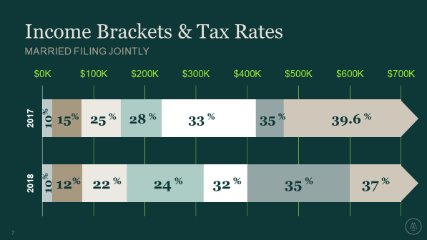
Individual Income Tax Brackets & Rates Updated (Married)
California Craft Brewers Association | www.CaliforniaCraftBeer.com

Slide 17
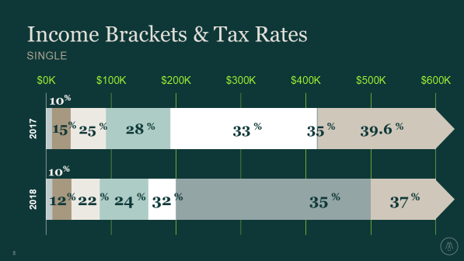
Individual Income Tax Brackets & Rates Updated (Single)
California Craft Brewers Association | www.CaliforniaCraftBeer.com

Slide 18
Updates to Exemptions & Itemized Deductions
Personal Exemptions – Suspended until 2026
Standard Deduction – Raised until 2026
Itemized Deductions – Severely Limited
State and Local Tax – Limited to $10,000
Mortgage Interest – Limited on new loans over $750,000
Mortgage Interest – No deduction for new HELOC’s
2% Itemized Deductions – Suspended until 2026, ex:
Investment fees
Union Dues
Safe Deposit Boxes
Tax Preparation Fees
California Craft Brewers Association | www.CaliforniaCraftBeer.com

Slide 19
Excess Business Losses
Government Revenue Raiser: Non-corporate taxpayer (ex: Individual owners) cannot deduct an “excess business loss”
Excess Business Loss: Effectively, equals a taxpayer’s net loss from all trades or businesses in excess of $500,000 (married) or $250,000 (other)
NOL Treatment: Excess business loss becomes treated as an NOL in subsequent year
Relationship to Other Loss Limitation Rules: The excess business loss rule applies after other loss limitation rules (e.g., basis limitations, “at risk” rules, passive activity rules)
Planning Opportunity – Review your personal tax situation if you have significant business losses and non-business income (ex: W-2 wages, interest/dividend income). Avoid April 15th surprises!
California Craft Brewers Association | www.CaliforniaCraftBeer.com

Slide 20
Thank you!
Additional questions? Kirk.Faris@Mossadams.com
Both the slides and a recording of this presentation available at www.CaliforniaCraftBeer.com
Please email feedback@californiacraftbeer.com with questions or comments
California Craft Brewers Association | www.CaliforniaCraftBeer.com

