Slide 1


Slide 2
Hop and Yeast Interactions
Brittney Berg – Lallemand Brewing
West Coast Technical Sales Manager

Slide 3
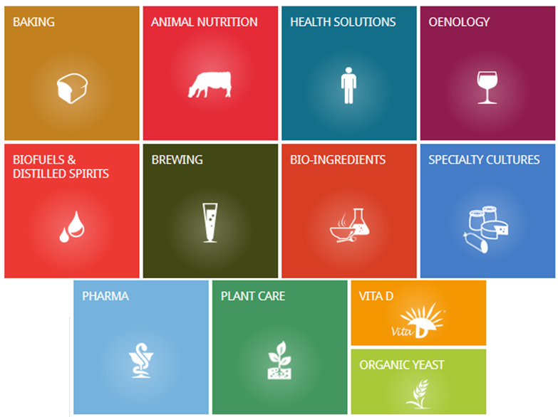
Lallemand’s Core Activity
Development, production and marketing of yeast and bacteria…. and their derivatives

Slide 4
Overview
A brief review of studies regarding hop derived compounds and how they are modified by yeast during fermentation
Starting off simple: Hop composition & yeast factors
Known Interactions
Hop Derived Compounds:
- Carbonyl Compounds
- Esters
- Monoterpene Alcohols
- Glycosidically bound precursors
- Hop Degradation Acids
- Thiol precursors
Trials

Slide 5
Background

Slide 6
What is “Biotransformation’?
Biotransformation = “alteration of organic compounds by organisms or enzymes ”
“an array of complex chemical processes during which yeast cells transform hop components into (new), often boldly aromatic compounds”
“oil components that yeast have modified”
“Yeast derived impact or modification of hoppy aroma”
Notes:
Biotransformation is not a one-dimensional thing,

Slide 7
Why “Biotransformation” ?
It’s a small (but important!) part of hoppy aroma in beer
We know that fresh/processed hop aromas are different then that of the final beer aroma
  Disproportionate extraction
  Losses by e.g. evaporation or adsorption
  Modification of hop derived volatiles by yeast enzymes
Notes:
Biotransformation is not a one-dimensional thing,

Slide 8
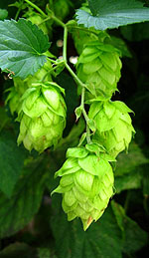
Hop Composition
POLYPHENOLS
RESINS
ESSENTIAL OILS
Notes:
Biotransformation is not a one-dimensional thing,

Slide 9
Hop Composition
ESSENTIAL OILS
  Hydrocarbon fraction (50-80%)
    Myrcene, Caryophellene, Farnesene, Humulene, …
  Oxygenated fraction (20-50%)
    Linalool, Geraniol, Nerol, …
  Sulphur fraction (<1%)
Notes:
Biotransformation is not a one-dimensional thing,

Slide 10
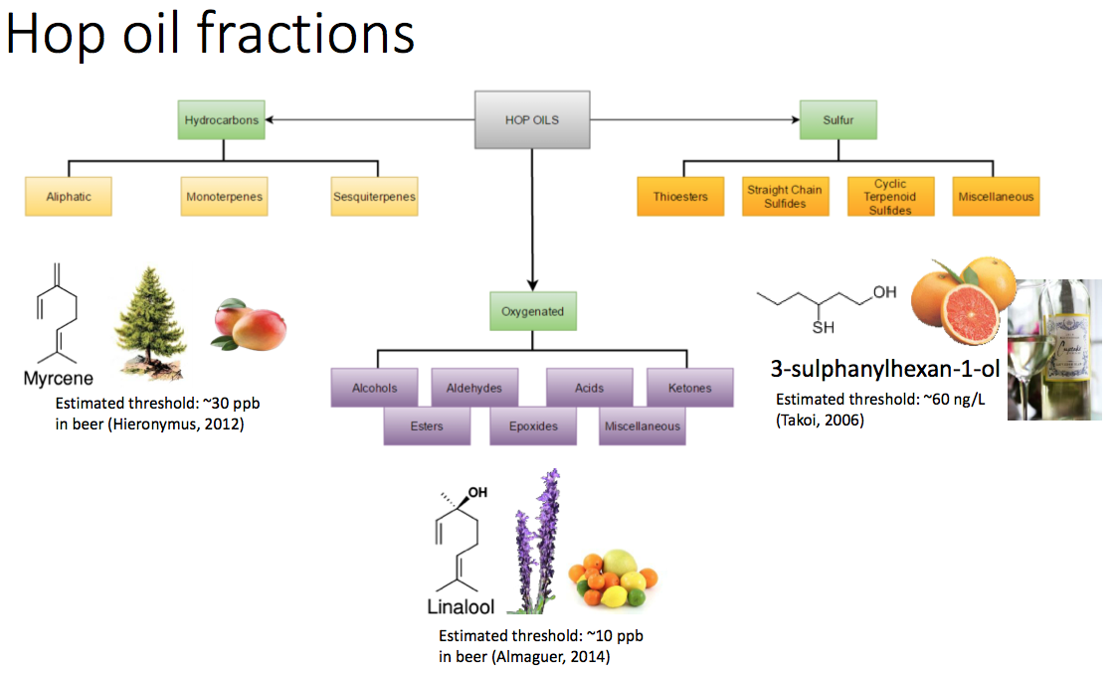

Slide 11
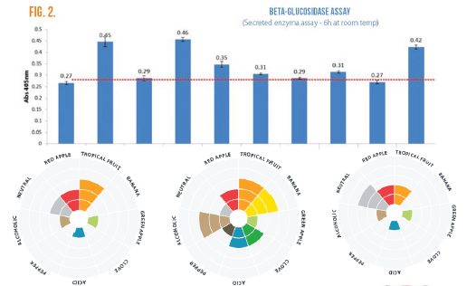
Yeast Factors
Yeast are complex
Many factors influence how yeast behaves

Slide 12
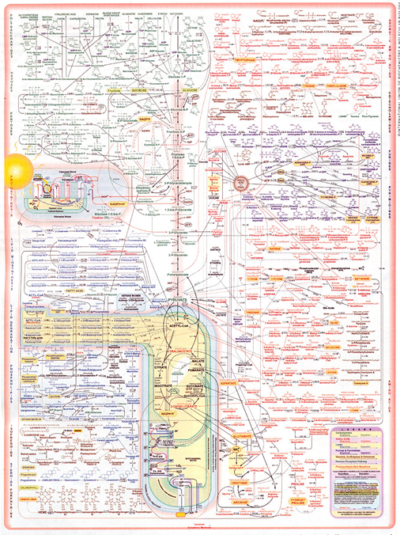

Slide 13
Yeast Factors: DH during late primary / early secondary
Reasons to dry hop with yeast:
  dissolved oxygen protection
  natural mixing by convection
  biotransformation of hop oil compounds
Things to consider:
  stripping of aroma
  loss of volatiles due to adsorption onto biomass

Slide 14
Commonly Known Interactions
Stripping compounds during fermentation_{(1,2)}
  CO2 production/Stripping
  Adsorption
Masking?
Biotransformation

Slide 15
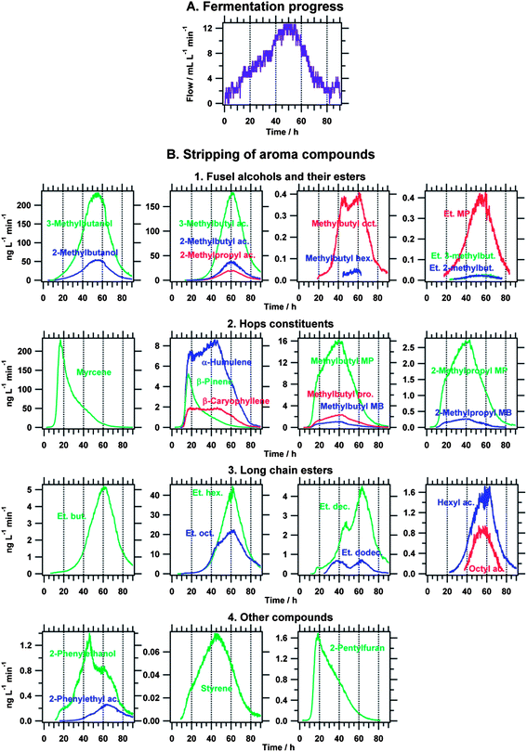
Volatile compounds are lost by stripping
carbon dioxide evolution rate
release curves of aroma compounds
time (h)
time (h)
time (h)
Haefliger and Jeckelmann, Anal. Methods, 2013, 5, 4409-4418

Slide 16
Influencing Factors (not discussed here)
Yeast strain
Cell count
Temperature
Point of hop addition
Contact time

Slide 17
Various Studies Review

Slide 18
Hop Derived Compounds
Carbonyl compounds (also from derived from malt, mashing, boiling)
Esters (branched chain esters, not found in unhopped beer)
Monoterpene alcohols
Glycosidically bound precursors
Acids
Polyfunctional thiols

Slide 19
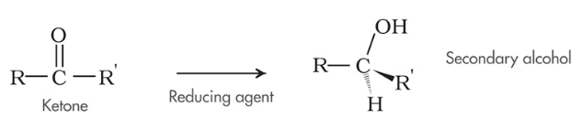
Carbonyl Compounds
Carbonyl → Alcohols
Dehydrogenases and reductases
Example: methyl ketones are partially reduced to the corresponding secondary alcohols₍₃₎

Slide 20
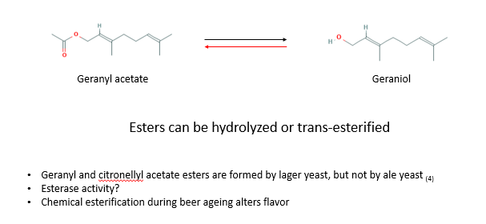
Esters

Slide 21
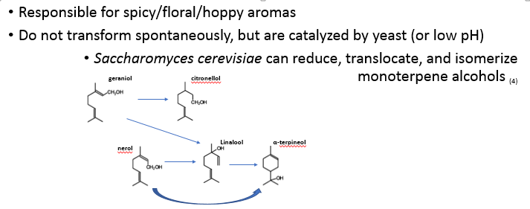
Monoterpene alcohols

Slide 22
Monoterpene alcohols - Geraniol
Research from e.g. Takoi et al. classified hops into two categories:
  Free geraniol dominant hops
  Geraniol precursor dominant hops
Sources of geraniol: free geraniol, geraniol precursors, and geranyl acetate(5)
Geraniol decreases during first 3 days of fermentation – is used for ergosterol biosynthesis (5)

Slide 23
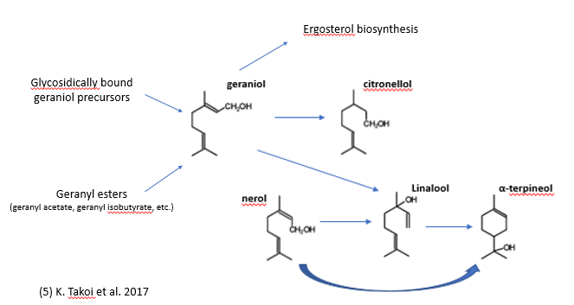

Slide 24
Glycosidically bound precursors
What are glycosides?
  Sugar bound molecules
  Non-volatile
  Found in hops₍₂₎
Research has shown that glycosidically bound aroma precursors are hydrolyzed.₍₂₎
  Non-aromatic compounds are hydrolyzed: releasing one aromatic compound, one glucose, and one molecule of water
  β-glucosidase enzyme

Slide 25
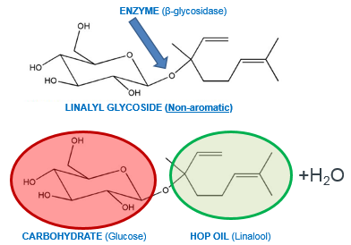
Glycoside Hydrolysis

Slide 26
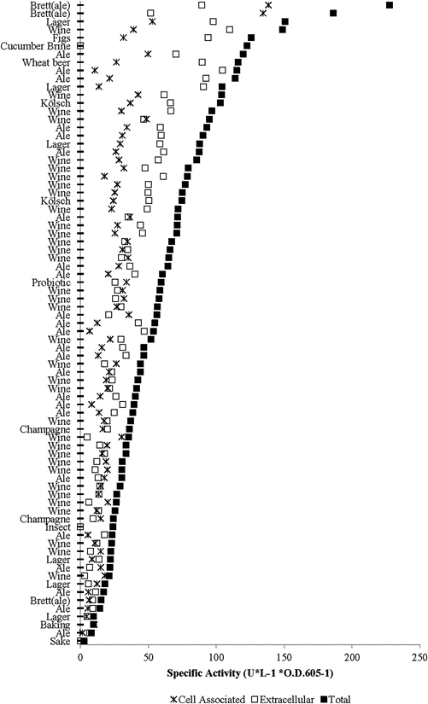
Glycosidically bound precursors
Researchers from OSU have done significant research in this area:
  Found evidence that hops contain substantial amounts of glycosidically bound volatiles
  Brewing yeast exhibit wide range of glycosidase hydrolysis activity
  Maximum hydrolysis occurs within 3 days of primary fermentation
  Since glycoside concentration in wort are low, yeast B-glucosidase activity makes small contributions to hop aroma

Slide 27
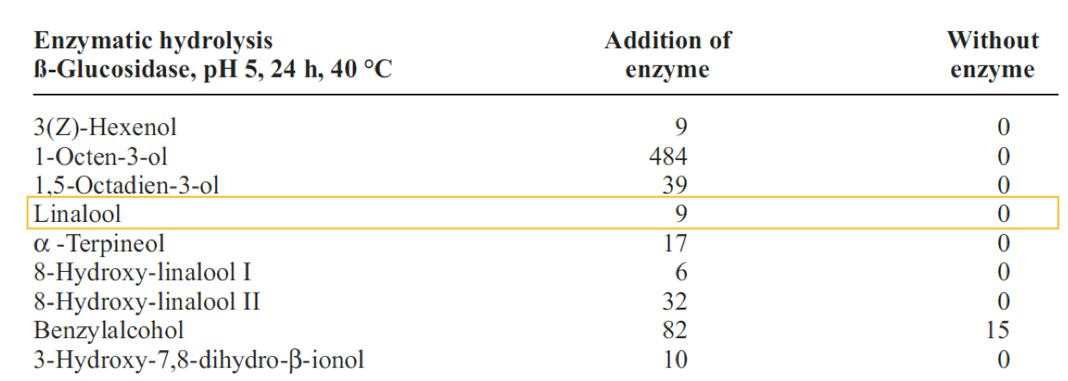
Sensory impacts
Kollmannsberger et al, 2006

Slide 28
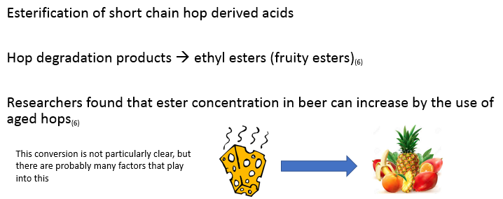
Hop degradation acids

Slide 29
Polyfunctional thiols
What are Thiols?
Sulfur containing compounds – highly potent
Free and bound forms available
  Bound: Cysteinylated and Glutathionylated thiol precursors are found in hops
  Non-volatile
Possible β-lyase activity catalyzing a release of aromatic thiols₍₇₎

Slide 30
Trials

Slide 31
Lallemand Trials - NaparBier
Commercial production of a Brut IPA at Naparbier
Wort split into two separate fermentations: BGl enzyme 1 addition vs. control
First dry hopping was at day 0, with addition of Chinook and Centennial hops; fermentation held at 18°C
A 2nd dry hop was added at day 12 using the same hop regime with Chinook and Centennial; temperatures lowered to 16°C.

Slide 32
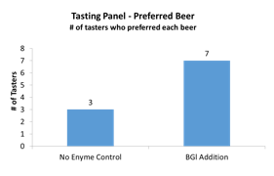
Lallemand Trials – Garage Beer Co.
Brewed their house IPA, 100g/hL dried yeast pitch
Control vs Addition of BGl enzyme

Slide 33
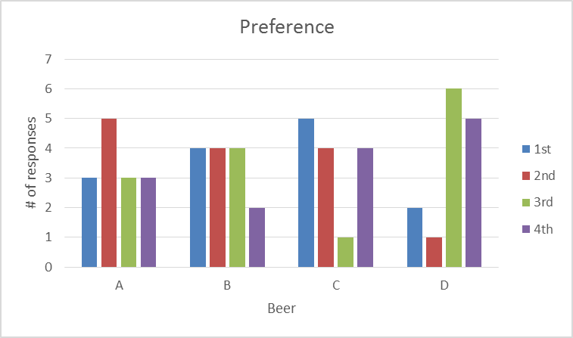
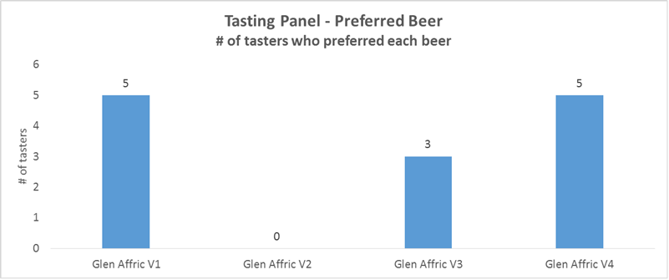
Glen Affric Beers – tasting Preference
A: Enzyme added at yeast pitch
B: No enzyme added
C: Enzyme added at yeast pitch + 25% of the dry hop
D: Enzyme added with the dry hop on day 4
NRC
Mascoma

Slide 34
Summary
Aroma of fresh/processed hops ≠ aroma of final beer
Changes of fermentation parameters or hopping regime can effect beer flavor
Biotransformation is complex and there is still a lot unknown
Room for exploration, creativity and research!

Slide 35
References
T. Shellhammer, ‘RE: Presentation help’. Message to: Brittney Berg, 26 December 2018. Email.
Sharp, D.; Molitor, A.; Shellhammer, T. Effect of hopping regime, cultivar, and yeast on terpene alcohol content in beer. Young Scientist Sympoisum. April 2016.
Praet, T.; Van Opstaele, F.; Jaskula-Goiris, B.; Aerts, G.; De Cooman, L. Biotransformations of hop-derived aroma compounds by Saccharomyces cerevisiae upon fermentation. Cerevisia, 36 (2012), 125-132.
King, A.J.; Dickinson, J.R. Biotransformation of Hop Aroma Terpenoids by Ale and Lager Yeasts. FEMS Yeast Research 2003, 3 (1), 53-62.
Takoi, K. et al. Systematic analysis of behavior of hop-derived monoterpene alcohols during fermentation and new classification of geraniol-rich flavor hops. BrewingScience. (70) 2017. 177-186
Rettberg, N.; Thörner, S.; Labus, A.B.; Garbe, L.-A. Aroma active monocarboxylic acids – origin and analytical characterization in fresh and aged hops. BrewingScience. (67) 2014. 33-47.
Nizet, S.; Gros, J; Peeters, F; Chaumont, S.; Robiette,R.; Collin, S. First Evidence of the production of odorant polyfunctional thiols by bottle refermentation. J. Am. Soc. Brew. Chem. 2013, 71 (1), 15-22.
& more:
Takoi et al. Biotransformation of hop-derived monoterpene alcohols by lager yeast and their contribution to the flavor of hopped beer. Journal of Agricultural and Food Chemistry. 58 (2010). 5050 – 5058.
Sharp, D.; Vollmer, D. Examination of glycoside hydrolysis methods for the determination of terpenyl glycoside contents of different hop cultivars. J. Am. Soc. Brew. Chem. 75(2) 2017, 101-108.
Gros, J. et al. Enzymatic release of odorant polyfunctional thiols from cysteine conjugates in hop. J. Inst. Brew. 2013. 119: 221-227.

Slide 36
Special thanks…….
Nils Rettberg
Brian Perkey
Robert Percival
Joan Montasell
Eric Abbott
Sylvie Van Zandycke
& all trial breweries!

Slide 37
Thank you!!

